Slide 1
Unlocking Automotive Trends Project
Student Name: Ayush Burman
Course 4 : Python For Data Science
Batch Code: DA464S46
Project Guide: Komilla Bhatia

Slide 2
Problem Statement
By analyzing the car dataset we want to gain insights into popular trends and identify key factors for launching promising car models. We want to extract actionable insights from the given data, address the key areas such as categorizing cars based on market segmentation, conduct fuel efficiency analysis, compare performance, study weight distribution, assess safety features, explore user comfort, analyze alert systems, and conduct dimensional analysis. Basically - a new car needs to be launched, and for that we must first understand the market preferences by analyzing the car data.
Objective
Safety Feature Assessment
User Comfort Exploration
Fuel Efficiency Analysis
Dimensional Analysis
Market Segmentation Analysis
2
2

Slide 3
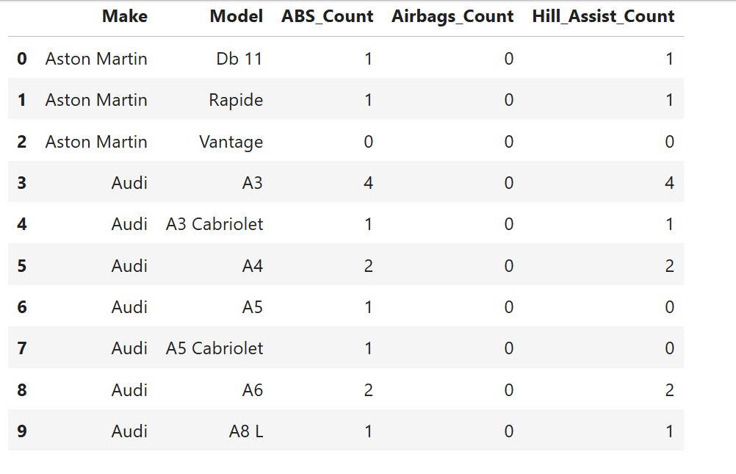
Safety Feature Assessment - Insights from the analysis
Key Insights:
ABS- Present in most high-end models like Audi A3, A4, A6, and some Aston Martin variants.
2. Airbags- Surprisingly, very few entries have recorded the presence of airbags(values are mostly missing or 'No').
3. Hill Assist- Common in premium variants(especially Audi), but absent in more basic or older models.
3

Slide 4
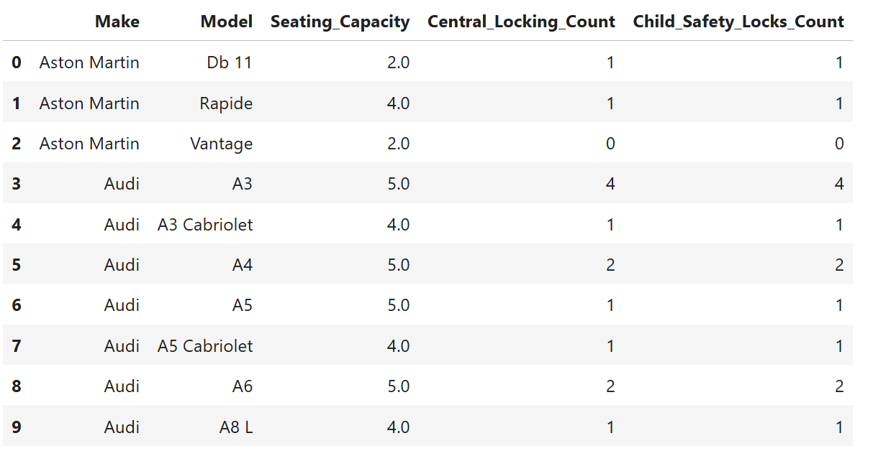
User Comfort Exploration - Insights from the analysis
Key Insights:
1. Seating Capacity: Most family-friendly models like the Audi A3, A4, A6 offer 5 seats on average, suitable for families.
2. Central Locking: Standard across most Audi models; fewer Aston Martin models include it.
3. Child Safety Locks: Consistently found in Audi models, including a family-focused design; rare in performance cars like the Vantage.
4

Slide 5
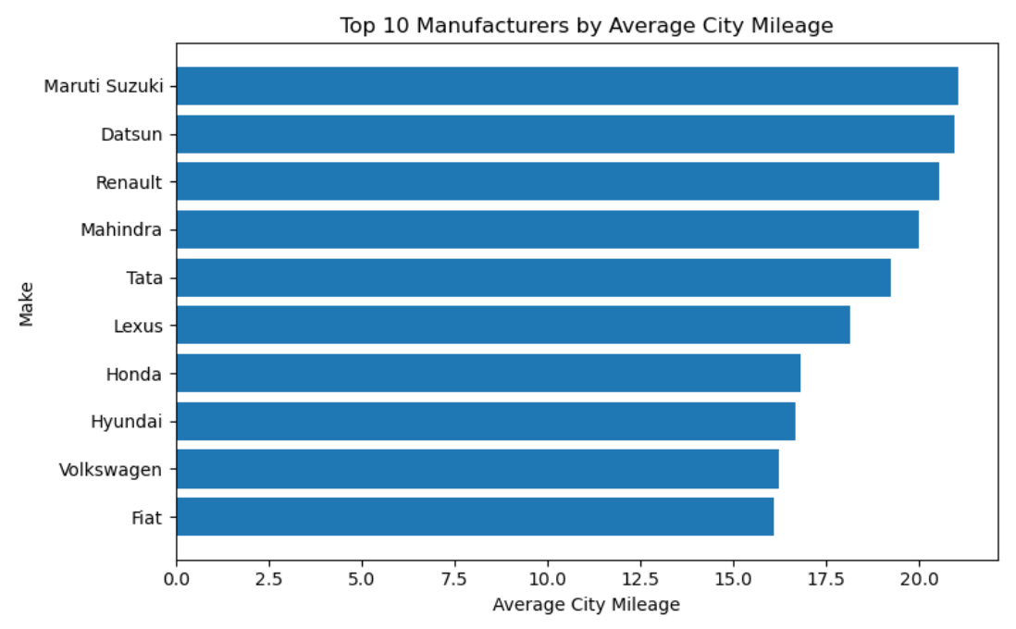
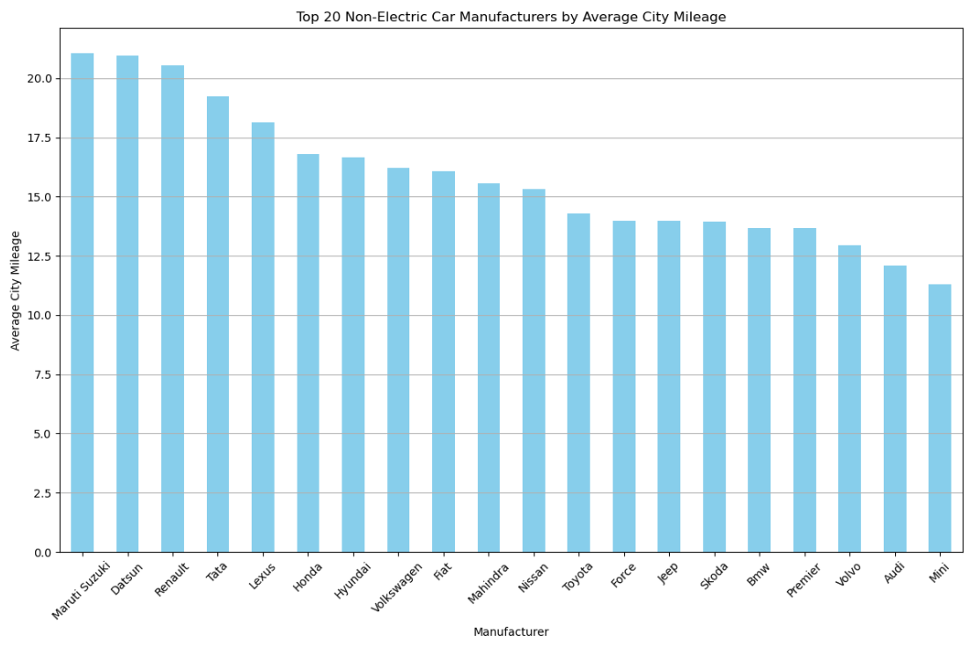
Fuel Efficiency Analysis - Insights from the analysis
Interpretation:
Top 10 Manufacturers by Average City Mileage:- This horizontal bar chart shows Maruti Suzuki and Datsun leading with approximately 20 MPG city mileage, followed closely by Renault at around 19.5 MPG. The top performers (Maruti Suzuki, Datsun, Renault, Mahindra, and Tata) all achieve between 18-20 MPG, suggesting these manufacturers focus on fuel-efficient city driving.
Interpretation:
Top 20 Non-Electric Car Manufacturers by Average City Mileage:- This chart provides a broader view of fuel efficiency across 20 manufacturers. The top performers (Maruti Suzuki, Datsun, Renault, Tata) maintain their leading positions with 20+ MPG. The bottom performers appear to achieve around 10-12 MPG, suggesting a focus on performance or larger vehicles rather than fuel economy.
5

Slide 6
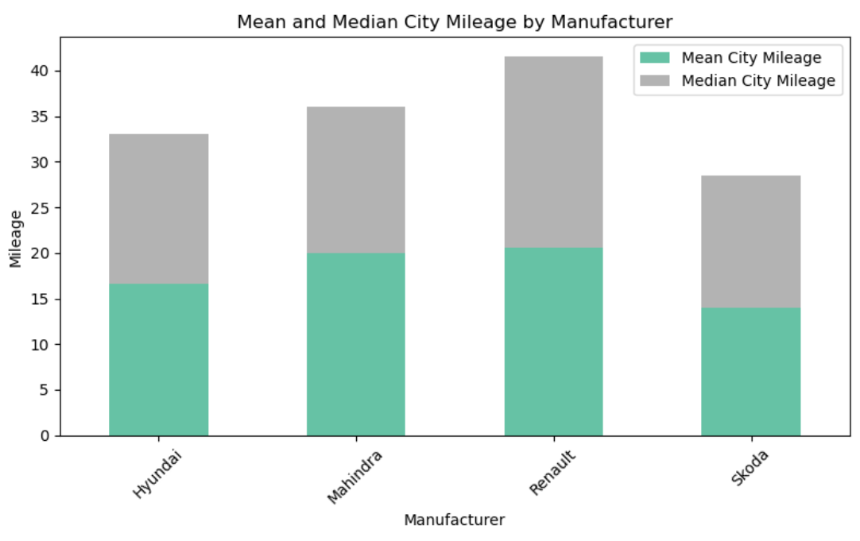
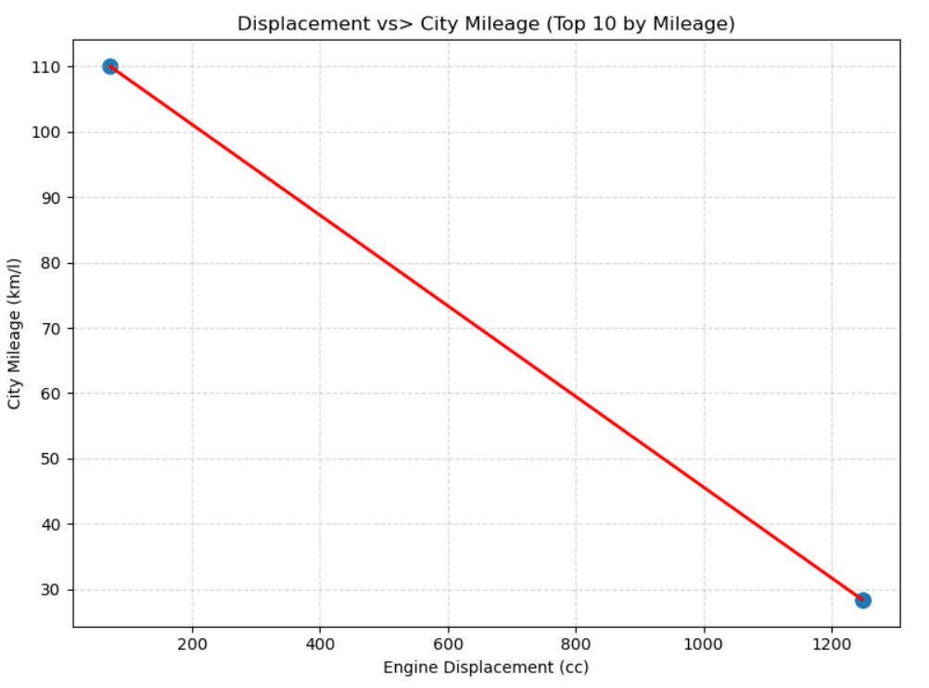
Fuel Efficiency Analysis - Insights from the analysis (continued)
Interpretation:
Mean and Median City Mileage by Manufacturer:- This stacked bar chart compares mean (teal) and median (gray) values for four manufacturers. Renault shows the highest total range (mean + median around 42 MPG combined), followed by Mahindra and Hyundai at similar levels. Skoda shows the lowest. This reveals that median values are consistently higher than mean values for all manufacturers, indicating that fuel efficiency distributions are likely skewed by some very low-efficiency vehicles pulling the averages down.
Interpretation:
Displacement vs City Mileage (Top 10 by Mileage):- This scatter plot with trend line demonstrates a strong negative correlation between engine displacement and city mileage. Starting at around 110 MPG for very small engines (near 100cc), efficiency drops dramatically as displacement increases. This suggests that manufacturers seeking better fuel economy should focus on smaller displacement engines, though this must be balanced against performance requirements and market demands for different vehicle categories.
6

Slide 7
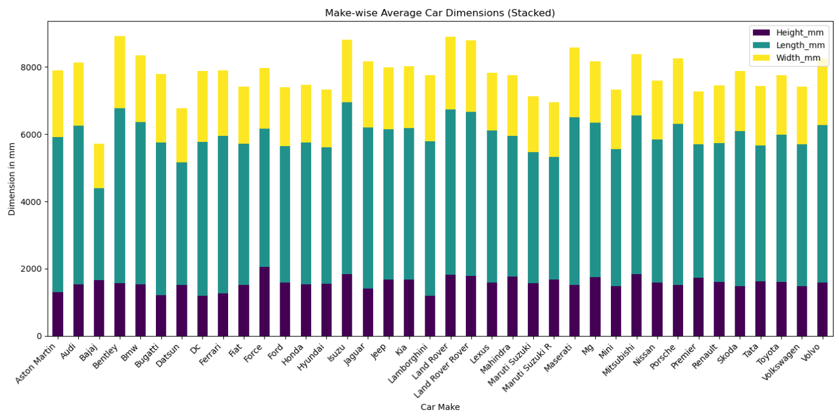
Dimensional Analysis - Insights from the analysis
Interpretation:
Make-wise Average Car Dimensions (Stacked):- There is significant variation in overall vehicle size across brands.
Interpretation:
Make-wise Average Car Dimensions (Stacked):- Key observations:
Largest vehicles: Bentley, Cadillac, and several luxury brands show the tallest stacked bars (around 9,500-10,000mm combined), suggesting they produce larger, more spacious vehicles
Smallest vehicles: Some manufacturers like Smart, Mini, and certain Asian brands show shorter stacked bars (around 8,000-8,500mm), indicating more compact vehicle designs
Proportional consistency: Most manufacturers show relatively consistent proportions between the three dimensions across their vehicle lineup, with length (teal) being the dominant component, followed by width (yellow), and height (purple) being the smallest.
Market positioning: Luxury brands tend toward larger dimensions while economy-focused brands favor compact designs, reflecting their target market preferences.
7

Slide 8
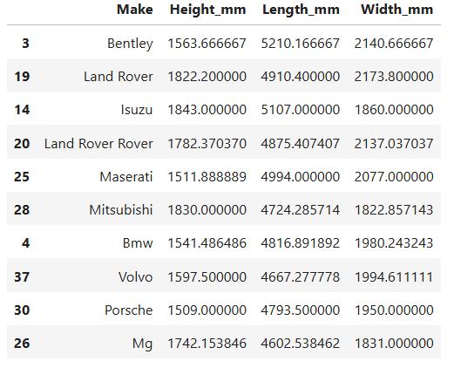
Dimensional Analysis - Insights from the analysis (continued)
Interpretation:-
This table provides precise measurements for 10 specific vehicle makes, revealing exact dimensional patterns:
Height Analysis:
Range: 1,509mm (Porsche) to 1,843mm (Isuzu)
Luxury sports cars (Bentley: 1,564mm, Porsche: 1,509mm) tend to be lower
SUV-oriented brands (Isuzu: 1,843mm, Land Rover: 1,822mm) are notably taller
Length Analysis:
Range: 4,602mm (MG) to 5,210mm (Bentley)
Bentley leads with 5,210mm, reflecting luxury sedan/coupe focus
Most vehicles cluster between 4,600-5,100mm, typical for mid-size to full-size vehicles
Width Analysis:
Range: 1,822mm (Mitsubishi) to 2,173mm (Land Rover)
Land Rover shows exceptional width (2,173mm), consistent with SUV design
Most manufacturers fall between 1,850-2,100mm width
Interpretation:-
Design Implications:
Bentley optimizes for luxury with maximum length but moderate height
Land Rover prioritizes SUV functionality with maximum width and high stance
Porsche maintains sports car profile with minimal height
The data reflects each brand's core vehicle category and target market positioning so that they can be sold accordingly.

Slide 9
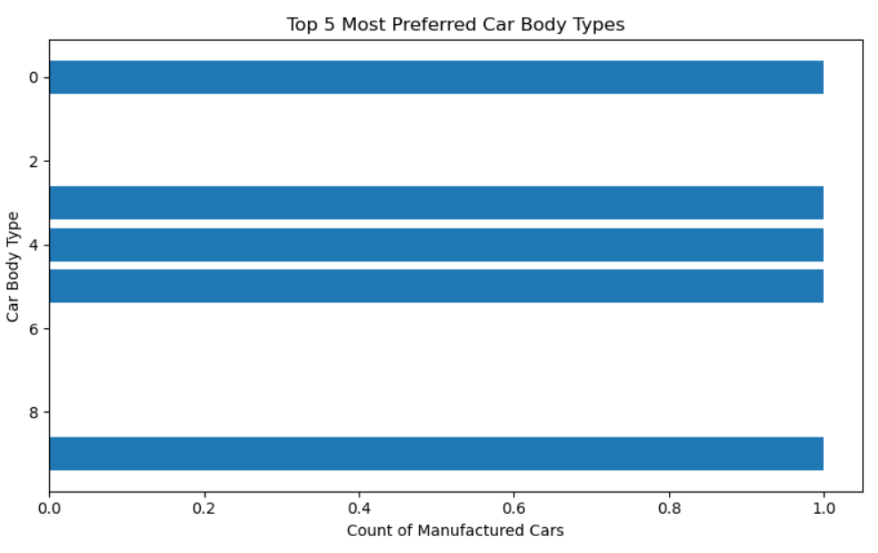
Market Segmentation Analysis - Insights from the analysis
Interpretation:-
Market Segmentation Analysis: Top 5 Most Preferred Car Body Types:
This horizontal bar chart reveals significant insights into automotive market segmentation based on body type preferences.
Market Dominance Pattern: The chart shows five distinct body types (labeled 0, 2, 4, 6, 8) with nearly equal market share, each representing approximately 1.0 (or 100%) of manufactured cars in their respective categories. This uniform distribution suggests a well-balanced market segmentation strategy across the automotive industry.
Interpretation:-
Strategic Implications:
Manufacturers should maintain balanced production across all five body types
Marketing strategies should be tailored to distinct demographic groups for each category
R&D investments should be distributed across all segments to maintain competitive positioning
This segmentation pattern suggests a stable, mature market with predictable demand patterns.
The numerical labeling (0, 2, 4, 6, 8) along the Y axis(Car Body Type) represents the 5 most preferred car body types.
9

Slide 10


Market Segmentation Analysis - Insights from the analysis (continued)
Interpretation:-
On filtering cars that support all 5 driving modes the result shows that 'one or more columns is missing' meaning that none of the cars in the given dataset list support all 5 driving modes.
Market Fragmentation Reality: The fact that zero vehicles offer the complete suite of Normal, Comfort, Eco, Sport, and Power modes indicates a highly fragmented market where manufacturers are making deliberate trade-offs rather than pursuing comprehensive solutions.
Strategic Recommendations:
Niche Targeting: Focus on 2-3 complementary modes that serve specific consumer segments
Future Product Development: Invest in technology to enable comprehensive mode integration
Market Research: Investigate consumer willingness to pay premium for all-mode capability
Competitive Advantage: Position complete mode integration as a key differentiator for next-generation vehicles
This analysis reveals that the automotive market is currently segmented by operational limitations rather than consumer preference, creating significant opportunity for innovation-driven market disruption.

Slide 11
Summary
In Safety Feature Assessment ABS- Present in most high-end models like Audi A3, A4, A6, and some Aston Martin variants. Airbags- Surprisingly, very few entries have recorded the presence of airbags(values are mostly missing or 'No'). Hill Assist- Common in premium variants(especially Audi), but absent in more basic or older models.
In User Comfort Exploration section most family-friendly models like the Audi A3, A4, A6 offer 5 seats on average, suitable for families. Central Locking is standard across most Audi models; fewer Aston Martin models include it. Child Safety Locks: Consistently found in Audi models, including a family-focused design; rare in performance cars like the Vantage.
In Fuel Efficiency Analysis the top performers (Maruti Suzuki, Datsun, Renault, Mahindra, and Tata) all achieve between 18-20 MPG, suggesting these manufacturers focus on fuel-efficient city driving. The top performers (Maruti Suzuki, Datsun, Renault, Tata) maintain their leading positions with 20+ MPG. Renault shows the highest total range(mean + median around 42 MPG combined), followed by Mahindra and Hyundai at similar levels. Median values are consistently higher than mean values for all manufacturers, indicating that fuel efficiency distributions are likely skewed by some very low-efficiency vehicles pulling the averages down. Scatter plot with trend line demonstrates a strong negative correlation between engine displacement and city mileage. Manufacturers seeking better fuel economy should focus on smaller displacement engines, though this must be balanced against performance requirements and market demands for different vehicle categories.

Slide 12
Summary
4. In Dimensional Analysis there is significant variation in overall vehicle size across brands. Largest vehicles: Bentley, Cadillac, and several luxury brands show the tallest stacked bars. Smallest vehicles: Some manufacturers like Smart, Mini, and certain Asian brands show shorter stacked bars. Proportional consistency: Most manufacturers show relatively consistent proportions between the three dimensions across their vehicle lineup. Market positioning: Luxury brands tend toward larger dimensions while economy-focused brands favor compact designs, reflecting their target market preferences. Design Implications: Bentley optimizes for luxury with maximum length but moderate height. Land Rover prioritizes SUV functionality with maximum width and high stance. Porsche maintains sports car profile with minimal height. The data reflects each brand's core vehicle category and target market positioning so that they can be sold accordingly.
5. In Market Segmentation Analysis the uniform distribution suggests a well-balanced market segmentation strategy across the automotive industry. There is a proportional consistency where this segmentation pattern suggests a stable, mature market with predictable demand patterns. The fact that zero vehicles offer the complete suite of Normal, Comfort, Eco, Sport, and Power modes indicates a highly fragmented market where manufacturers are making deliberate trade-offs rather than pursuing comprehensive solutions.

Slide 13
Conclusion
In Safety Feature Assessment objective features like ABS, Airbags, Hill Assist should be available across more car makes and models as in today's day and age these are a necessity and should not be exclusive to certain specific car makes and models. More R&D is required to make these safety features become more affordable and generalized even if there is some increase in cost for the customers.
In User Comfort Exploration objective there should be no compromise on features like Central Locking and Child Safety Locks regardless of the car make, model, type, segment etc. It should be standard across all vehicle makes and models.
In Fuel Efficiency Analysis objective most manufacturers are focusing on fuel efficient city driving also performance along with fuel efficiency should be prioritized to- more resources should be put into implementing that. As fuel efficiency distributions are likely skewed by some very low-efficiency vehicles pulling the averages down fuel efficiency needs to be prioritized across all manufacturers to maintain a consistent average. Manufacturers seeking better fuel economy should focus on smaller displacement engines, though this must be balanced against performance requirements and market demands for different vehicle categories.
13

Slide 14
Conclusion
In Dimensional Analysis Luxury brands tend toward larger dimensions while economy-focused brands favor compact designs, reflecting their target market preferences where most manufacturers show relatively consistent proportions between the three dimensions across their vehicle lineup, with length being the dominant component, followed by width, and height being the smallest. Even in economy focused brands where it's focused on compact designs there should be no compromise on the basic comfort of customers. The data reflects each brand's core vehicle category and target market positioning so that they can be sold accordingly which is a good thing.
In Market Segmentation Analysis Manufacturers should maintain balanced production across all five body types. Marketing strategies should be tailored to distinct demographic groups for each category. R&D investments should be distributed across all segments to maintain competitive positioning. This segmentation pattern suggests a stable, mature market with predictable demand patterns. This uniform distribution suggests a well-balanced market segmentation strategy across the automotive industry. On filtering cars that support all 5 driving modes the result shows that 'one or more columns is missing' meaning that none of the cars in the given dataset list support all 5 driving modes. Market Fragmentation Reality: The fact that zero vehicles offer the complete suite of Normal, Comfort, Eco, Sport, and Power modes indicates a highly fragmented market where manufacturers are making deliberate trade-offs rather than pursuing comprehensive solutions. This analysis reveals that the automotive market is currently segmented by operational limitations rather than consumer preference, creating significant opportunity for innovation-driven market disruption.
14

Slide 15
THANK YOU

